Slide 1
POLS0008
INTRODUCTION TO QUANTITATIVE RESEARCH METHODS
WEEK TWO: EXAMINING DATA (PART I)
Dr Andreas Mastrosavvas (a.mastrosavvas@ucl.ac.uk)
1
Notes:
Welcome to week two's lecture – examining data (part 1).
We are going to learn more further methods for summarising data using measures for central tendency – central tendency measures are values used to indicate where the center is in your dataset.
These measures are very useful as they are the most basic way to summarise data set with a single value.

Slide 2
RECAP OF LAST WEEK
2
Notes:
But before we start, let’s do a quick recap on stuff we learnt last

Slide 3
Definition of Statistics?
Statistics is the science of collecting, organising, analysing and interpreting numerical data to assist in making a more informed decision
In short – statistics is the science of crunching data and getting some meaningful information from it
It is typically use to summarising data points aka samples, and testing a hypothesis using such sample to make predictions about a population OR determine causal relationships
3

Slide 4
Definition of Statistics?
Composed of three main facets: Description, Inference, and Design
The descriptive and inferential elements are what we refer to as statistical analysis
Descriptive (explorative) statistics
Inferential (evidence-based) statistics
Describing ways the data looks
Summarizing the data that has been collected
Design: Cross-sectional and ecological framework
Hypothesis generating exercise
Making prediction (or future forecasts) about the wider population
Evidence-based research for testing hypothesis and making conclusions
Causal inference
Design: Case-control, cohort and RCTs framework
4

Slide 5
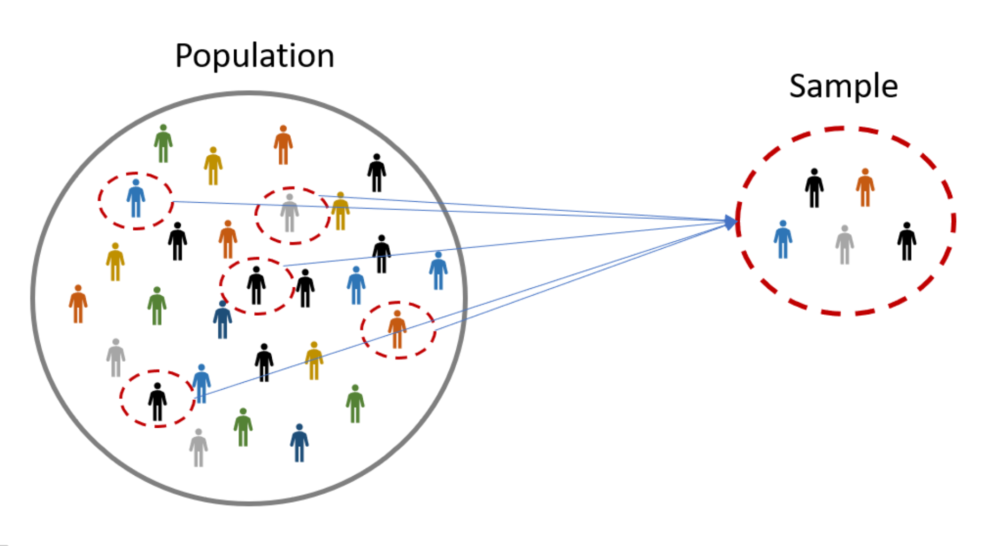
Population
This is the entire set of data points we wish to study (e.g., individuals, businesses, geographical units etc.)
Sample
This is a subset of data points chosen for study through data collection (preferably, probabilistic data collection approach)
Analysis of sample
Here, we conduct our statistic analysis on the subset of data points drawn from the population.
Whatever descriptive summaries or inferences made on this sample – its representative & generalisable of the population its from.
5
Notes:
We use the term "Population” to simply refer all data points (i.e., all members/subjects/items) under consideration for an analysis. Note that its impossible to have information about all members, or units of population, and therefore we collect a sample. The term sample is basically a subset of members/subjects/items selected for study that’s representative of the population its from.

Slide 6
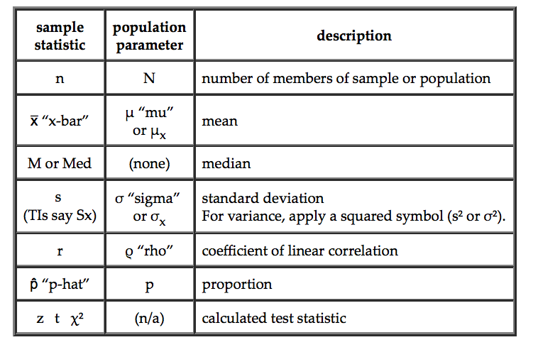
More (very basic) Statistical Notation
6
Notes:
A parameter is any measured quantity of a statistical population that summarises or describes an aspect of the “population”
A statistic or estimate is a numerical summary is any measured quantity of a statistical population that summarises or describes an aspect of the “population”

Slide 7
Type of Variables
A variable is anything that we can measure about the subjects in our sample
Variables vary, that is they take on a range of values
There are two classifications of variables
Levels of measurement: (Lowest) Nominal << Ordinal << Interval << Ratio (Highest)
Continuous Variables
Categorical Variables
Interval
Ratio
Nominal
Ordinal
We defined what independent and dependent variables are.
7
Notes:
A variable can anything – its an attribute that describes data points of a sample – this can be person, place, thing or idea. The value of the variable can "vary" or change from one entity (i.e., person, place, thing or idea) to another.
A variable can classified continuous or categorical – the former is quantitative and latter qualitative.

Slide 8
What are Descriptive Statistics?
Univariable analysis
Analysis of only one variable on some characteristic
Frequency Distributions – essentially a count or distribution of values on some single variable
Other descriptive statistics – some summary measure that describes the data in a way not obvious by looking at the frequency distribution
Bivariable analysis
Analysis of two variables – can be simple scatter plots or cross-tabulations
Multivariable analysis
Analysis of three or more variables
8
Notes:
Descriptive statistics are not used to make inferences to the population
Descriptive statistics (including frequency distributions) are a good way to get a first glimpse at data
Not very powerful in terms of analysis
Are a good place to start when you come across a new set of data
Best used as complements to other forms of analysis
Can be used for some qualitative work like case studies or to look at a larger pattern when investigating a micro-level phenomenon
Can be used with other forms of quantitative analysis to provide introductory remarks or support the forms of analysis being used

Slide 9
We created a table that contains group categories for height (of 5cm) measurement, and compute the frequency and proportions. In addition, we compute the cumulative frequency and its cumulative proportion as well.
94, 95, 97, 97, 100, 100, 101, 102, 103, 105, 105, 108, 108, 109, 109, 112, 113, 113, 118, 119, 121
Height groups | Frequency | Relative Frequency or percentage (%) | Cumulative Frequency | Cumulative Relative Frequency
90-95 | 2 | 0.09523810 (9%) | 2 | 0.09523810 (9%)
96-100 | 4 | 0.19047619 (19%) | 6 | 0.2857143 (28%)
101-105 | 5 | 0.23809524 (24%) | 11 | 0.5238095 (52%)
106-110 | 4 | 0.19047619 (19%) | 15 | 0.7142857 (71%)
111-115 | 3 | 0.14285714 (14%) | 18 | 0.8571429 (85%)
116-120 | 2 | 0.09523810 (9%) | 20 | 0.9523810 (95%)
120+ | 1 | 0.04761905 (4%) | 21 | 1.0000000 (100%)
We group the data points accordingly
94, 95
97, 97, 100, 100
101, 102, 103, 105, 105
108, 108, 109, 109
112, 113, 113
118, 119
121
This output is called a “Frequency Distribution table”, it’s visual representation is a histogram for the data’s relative frequency and cumulative frequency plot for the cumulative frequency.
9

Slide 10
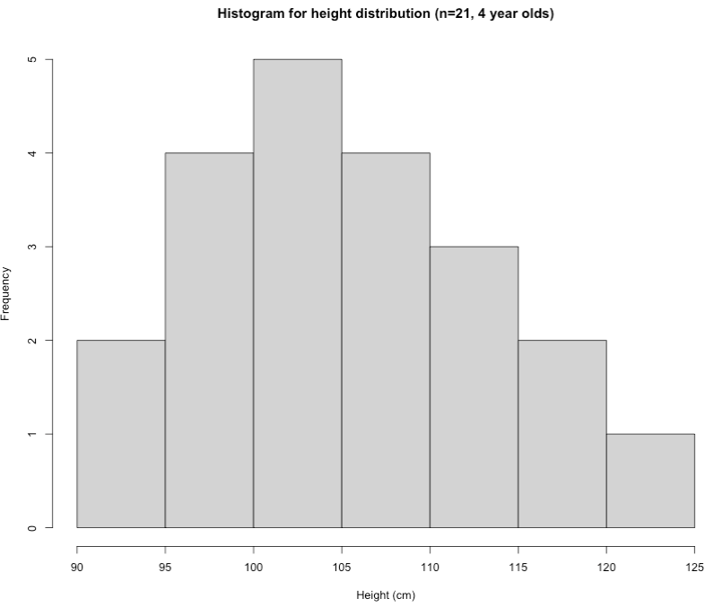
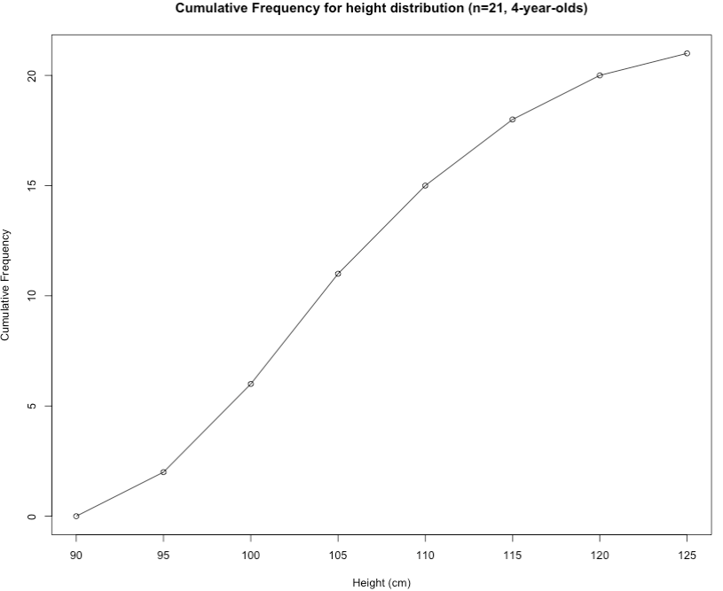
Interpretation: The above table output show the frequency distribution of heights (in cm) in kids who are 4 years of age entering in reception. The group with the highest frequency was 101-105 cm which accounts for 24% of the data. Health-wise, we can see from the cumulative frequency results that there are 6 kids with height values that are less than 101 cm. This corresponds to 0.2857 (29%) of the data – descriptively, these 6 kids growth is a cause for concern.
10

Slide 11
Summary Statistics
11

Slide 12
Summary measures
What kinds of analysis and summary statistics can you perform on a particular type of dataset?
1. Categorical Data
2. Numerical Data
You can group the data by according to categories and perform the following:
Compute the Frequencies (counts)
Compute the Percentages (or Relative Frequency)
Calculate the Cumulative Frequencies or Cumulative Percentages
Graphical approaches also include bar plots and pie charts
The Mode (category with that occurs most)
You can perform the following analysis:
Compute the mode (value that occur most)
Compute the median
Compute the mean
Lowest (Minimum) & Highest (Maximum)
Percentiles
Variance
Standard deviation
Range
Quartiles and Interquartile ranges
12
Notes:
When performing descriptive statistics using summary measures – you need to consider the type of variables you going to analyse…
If its categorical (i.e., nominal or ordinal) – then its to consider using the frequency distributions
However, if the variables are numerical (i.e., interval or ratio) – then you should compute the central tendency and dispersion measures to describe and summarise your dataset.

Slide 13
Format of today’s lesson goes…
Theory & Application
15-minute break
Presentation of results
Live demonstration in RStudio
13

Slide 14

Lecture
14
Notes:
Alright now… let’s begin lectures now!

Slide 15
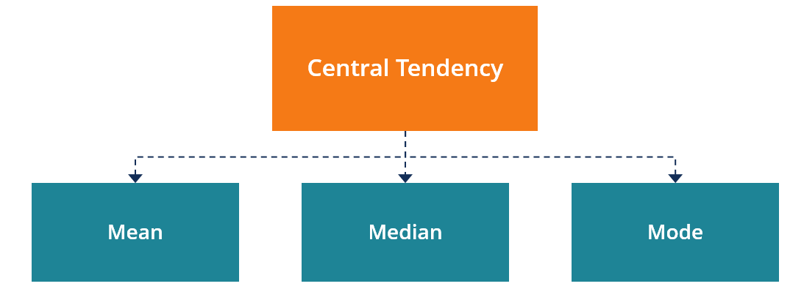
Central Tendency
Indicate the location of the middle or the centre of a distribution
Central tendency is the point at which the distribution is in balance
15
Notes:
When dealing with numerical/continuous data for summary statistics - two important questions you probably ask about variables in our dataset:
1.) What single estimate can I compute to best describe my data? For example, you have collected the stats marks recorded as a score out of 100 marks from 50 students
2.) What is the spread of data values around single estimate I have compute?
The answer to our first question i.e., what single number best represent our data, will be some number of central tendency. Now, a central tendency are values that indicate where the centre of the distribution tends to be.

Slide 16
Measures of Central Tendency
Indicate the location of the middle or the centre of a distribution
Central tendency is the point at which the distribution is in balance
16
Notes:
Generally, the central tendency of a dataset can be described using the following measures:
Mean (Average): Represents the sum of all values in a dataset divided by the total number of the values.
Median: The middle value in a dataset that is arranged in ascending order (from the smallest value to the largest value). If a dataset contains an even number of values, the median of the dataset is the mean of the two middle values.
Mode: Defines the most frequently occurring value in a dataset. In some cases, a dataset may contain multiple modes while some datasets may not have any mode at all.

Slide 17
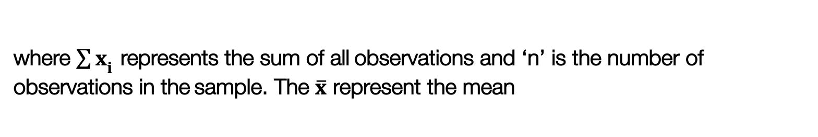
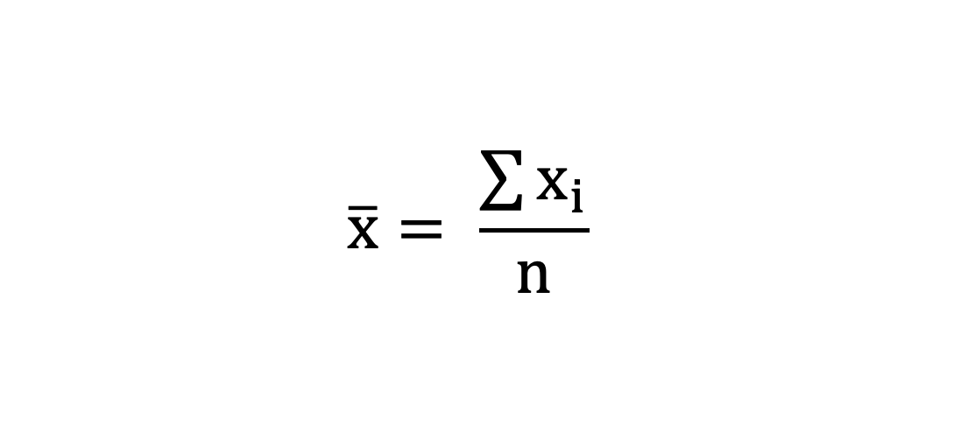
Mean
Arithmetic Mean (also referred as the word Average) is a central estimate
Takes into account all values
Mean is the preferred measure of central tendency,
except when there are extreme values
Easily distorted by extreme values
$$\overline{x}= \frac{\sum{x_{i}}}{n}$$
where ${\sum{x}}_{i}$ represents the sum of all observations and ‘n’ is the number of observations in the sample. The $\overline{x}$ represent the mean
17
Notes:
Mean (Average): Represents the sum of all values in a dataset divided by the total number of the values.

Slide 18
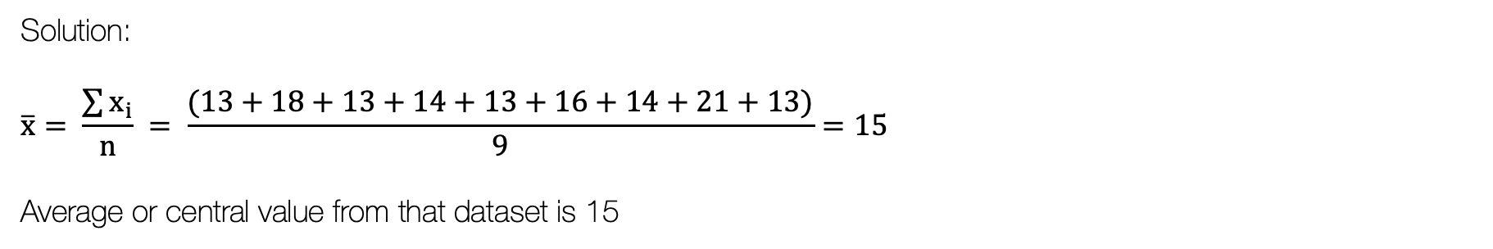
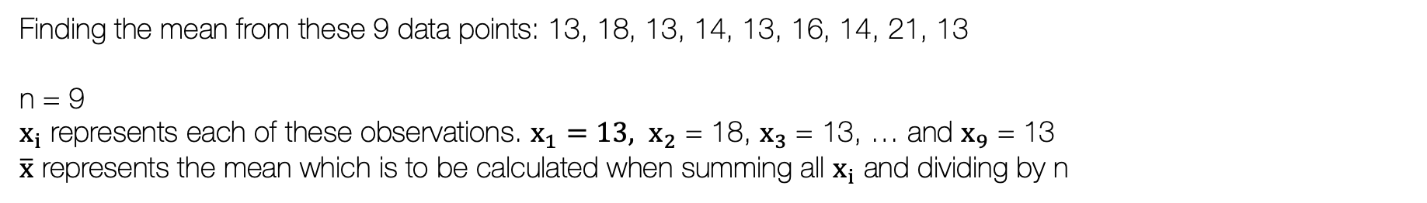
Example of Summarising Numerical Data using Mean
Finding the mean from these 9 data points: 13, 18, 13, 14, 13, 16, 14, 21, 13
n = 9
$x_{i}$ represents each of these observations. $x_{1}=13, x_{2}$ = 18, $x_{3}$ = 13, … and $x_{9}$ = 13
$\overline{x}$ represents the mean which is to be calculated when summing all $x_{i}$ and dividing by n
Solution:
$$\overline{x}= \frac{\sum{x_{i}}}{n} = \frac{(13+18+13+14+13+16+14+21+13)}{9}=15$$
Average or central value from that dataset is 15
In RStudio, the code for this would be:
datapoints <- c(13, 18, 13, 14, 13, 16, 14, 21,13)
mean(datapoints)
18

Slide 19
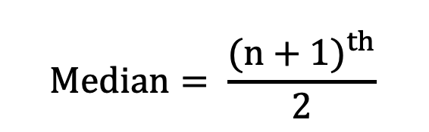
Median
Median is the exact middle value
Half of the values are smaller than the median and half are larger
The median divides the distribution in two equal parts
$$Median= \frac{{(n+1)}^{th}}{2}$$
the value of ordered observations
19

Slide 20
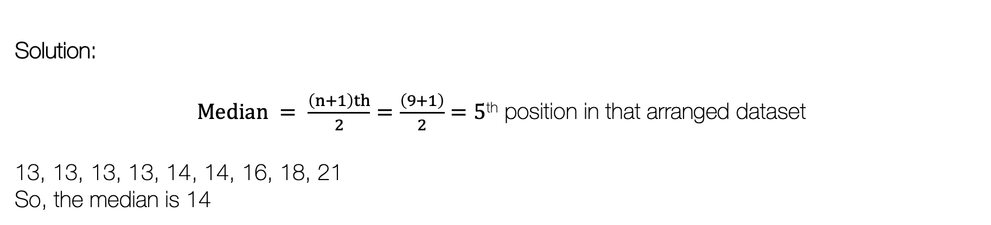
Example of Summarising Numerical Data using Median
Finding the median from these 9 data points: 13, 18, 13, 14, 13, 16, 14, 21, 13
n = 9
Arrange the values in ascending order:
Before: 13, 18, 13, 14, 13, 16, 14, 21, 13
After: 13, 13, 13, 13, 14, 14, 16, 18, 21
In RStudio, the code for this would be:
datapoints <- c(13, 18, 13, 14, 13, 16, 14, 21,13)
median(datapoints)
Solution:
$Median = \frac{\left(n+1\right)th}{2}=\frac{\left(9+1\right)}{2}=5$^{th} position in that arranged dataset
13, 13, 13, 13, 14, 14, 16, 18, 21
So, the median is 14
20

Slide 21
Things to know about the Mean & Median [1]
The Mean is influenced by extreme values
The Median is not influenced by extreme values
Distribution A
2 3 4 5 20
Mean
2+ 3+ 4+ 5+ 20 / 5
34 / 5 = 6.8
Median
5 + 1 / 2 = 3rd obs.
= 4
Distribution B
2 3 4 5 6
Mean
2+ 3+ 4+ 5+ 6 / 5
20 / 5 = 4
Median
5 + 1 / 2 = 3rd obs.
= 4
21

Slide 22
Median values are different when sample size contains an odd or even number of data points
Things to know about the Mean & Median [2]
Rank data from the lowest to the highest value median is rank calculated from (n+1)/2
Odd (n = 5)
14, 17, 18, 20, 21
Median = (n +1)/ 2
Median = (5 + 1)/ 2 = 3rd obs
14, 17, 18, 20, 21
Median = 3rd obs = 18
Even (n = 4)
14, 17, 18, 20
Median = (n +1)/ 2
Median = (4+1/2 = 2.5th obs
14, 17 || 18, 20
Median = 2.5th obs = 17.5
22

Slide 23
Measure for Dispersion & Variation [1]
NOTE: Measures of central tendency give us measures of where the middle of a set of data occurs - it is not enough to report only measures of central tendencies
This is where measure for variation and dispersion steps in…
These measure describe how the data is clustered or dispersed around the mean.
Measures of variation determine the range of the distribution relative to the measures of central tendency
23
Notes:
(n+1)/4th value of ordered obs.
It’s the number below which lies the 25% of the bottom data
Divides the range in the middle & has 50% of the data below it
3*(n+1)/4th value of ordered obs.
It has 75% of the data below it & the top 25% of the data above it

Slide 24
Measure for Dispersion & Variation [2]
These estimates basically determine the spread and range of values
It determines how the distribution are relative to the measures of central tendency:
Range (Maximum & Minimum value)
Upper and lower quartiles (i.e., 75th & 25th Percentiles), and Interquartile range
Variance to estimate the Standard Deviation
24

Slide 25
Range (minimum & maximum)
Range gives the extreme values
The difference between the min and max values
= highest value – lowest value
Lowest value
13, 13, 13, 13, 14, 14, 16, 18, 21
Highest value
In RStudio, the code for this would be:
datapoints <- c(13, 18, 13, 14, 13, 16, 14, 21,13)
max(datapoints)
Min(datapoints)
max(datapoints) – min(datapoints)
Range = 21 – 13 = 8
25

Slide 26
Quartiles and Interquartile range
Divide a range of data into four equal parts 100/4 parts = 25%
Lower quartile (1st quartile, Q1) (aka 25th percentile)
(n+1)/4 value of ordered obs.
It’s the number below which lies the 25% of the bottom data
2nd quartile (the median, Q2) (aka 50th percentile)
Divides the range in the middle & has 50% of the data below it
Upper quartile (3rd quartile, Q3) (aka 75th percentile)
3*(n+1)/4 value of ordered obs.
It has 75% of the data below it & the top 25% of the data above it
29
26
Notes:
(n+1)/4th value of ordered obs.
It’s the number below which lies the 25% of the bottom data
Divides the range in the middle & has 50% of the data below it
3*(n+1)/4th value of ordered obs.
It has 75% of the data below it & the top 25% of the data above it
The interquartile range is a measure of where the “middle fifty” is in a data set

Slide 27
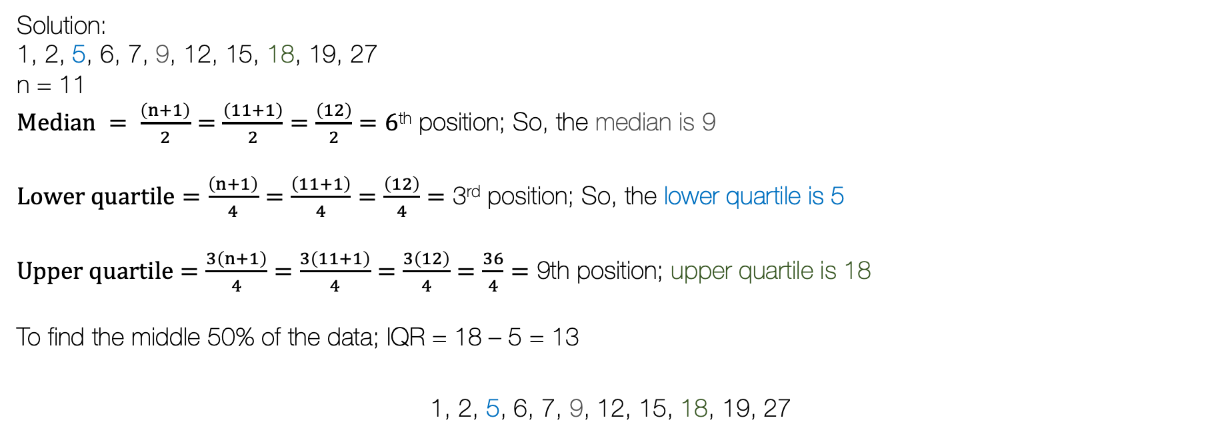
Example of Summarising data using quartiles and IQRs
Find the median, the lower and upper quartile from these data points: 1, 2, 5, 6, 7, 9, 12, 15, 18, 19, 27
Solution:
1, 2, 5, 6, 7, 9, 12, 15, 18, 19, 27
n = 11
$Median = \frac{\left(n+1\right)}{2}=\frac{\left(11+1\right)}{2}=\frac{\left(12\right)}{2}=6$^{th} position; So, the median is 9
$Lower quartile=\frac{\left(n+1\right)}{4}=\frac{\left(11+1\right)}{4}=\frac{\left(12\right)}{4}=\text{3}\text{rd}$position; So, the lower quartile is 5
$Upper quartile=\frac{3\left(n+1\right)}{4}=\frac{3\left(11+1\right)}{4}=\frac{3\left(12\right)}{4}=\frac{36}{4}=\text{9}\text{th}$position; upper quartile is 18
To find the middle 50% of the data; IQR = 18 – 5 = 13
1, 2, 5, 6, 7, 9, 12, 15, 18, 19, 27
In RStudio, the code for this would be:
datapoints <- c(1, 2, 5, 6, 7, 8, 9, 12, 15, 18)
summary(datapoints)
Lower 25%
Middle 50% of the data
Upper 25%
27

Slide 28
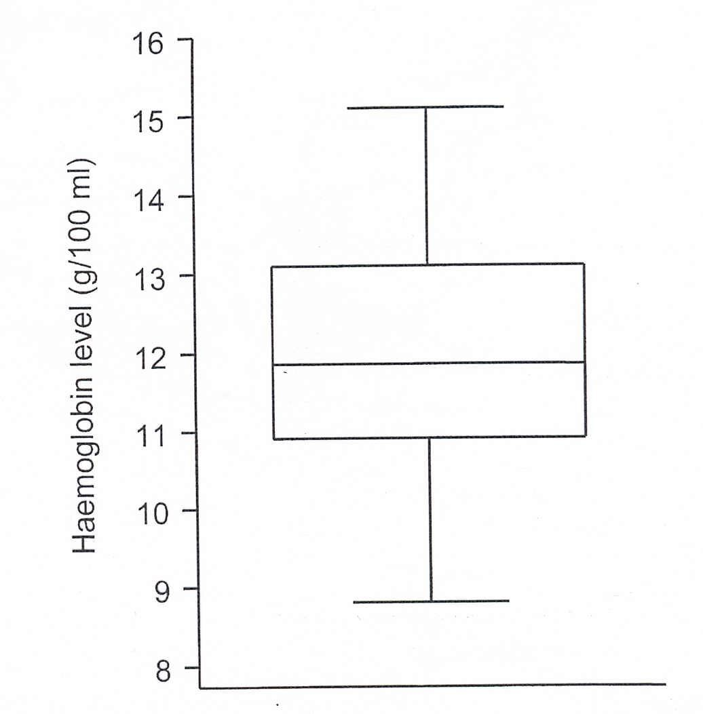
Box (whiskers) plot [1]
Why are box plots useful?
Box plots divides the data into section that each contain 25% of the data in the section
They provide a visual summary to quickly identify the pattern i.e., central and dispersion.
If its perfectly symmetrical (which most box plots are not) it is safe to assume the data is normally distributed, otherwise its skewed
Highest value
Upper quartile (75th percentile)
Median
Lower quartile (25th percentile)
Lowest value
25%
Whisker
25%
25%
25%
Whisker
28

Slide 29
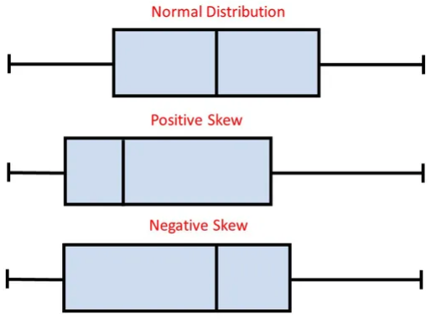
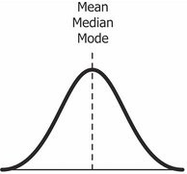
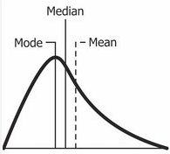
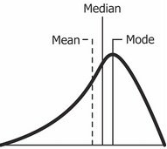
Box (whiskers) plot [2]
The box plot looks really centred on the median – so the distribution is considered normal. Traits: Mean, Median and Mode are the same
The box plot shows the median centred on the left – so the distribution is considered positively skewed. Traits: Mode < Median < Mean
The box plot shows the median centred on the right – so the distribution is considered negatively skewed. Traits: Mode > Median > Mean
29

Slide 30
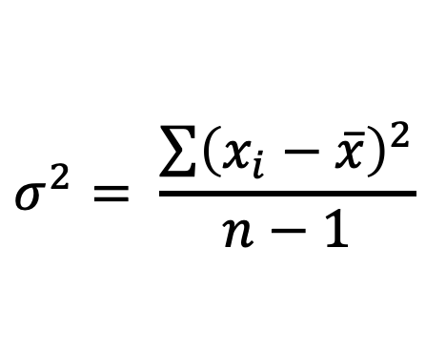
Variance
It is defined in terms of the deviations of the observations from the mean
Measures the spread about the mean
Measures ‘somewhat’ the average distance between to observation and mean value
We need to calculate this in order to get the standard deviation
Low value for (↓) S² = data are clustered about the mean
$$σ^{2}= \frac{\sum{{\left(x_{i}−\overline{x}\right)}^{2}}}{n−1}$$
High value (↑) S² = data are spread
Or disperse
30

Slide 31
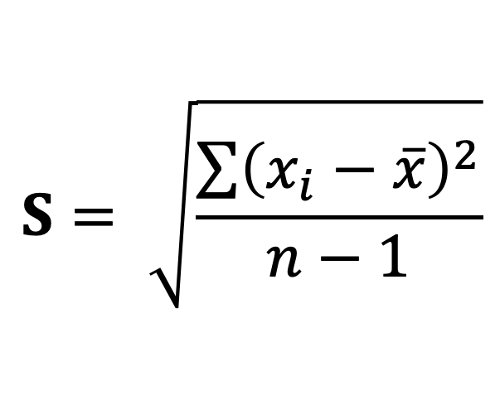
Standard Deviation
It is more convenient to express the variance in
the original unit by taking the square root of the variance
$$S= \sqrt{\frac{\sum{{\left(x_{i}−\overline{x}\right)}^{2}}}{n−1}}$$
31

Slide 32
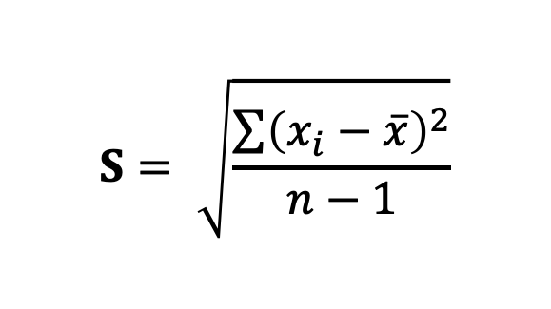
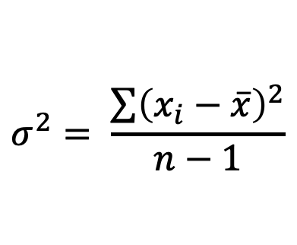
Example: Variance and Standard Deviation
Recall finding the mean from these 9 data points: 13, 18, 13, 14, 13, 16, 14, 21, 13
We estimated it as 15
Let measure how this data spreads around this value by calculating the variance and standard deviation
$$S= \sqrt{\frac{\sum{{\left(x_{i}−\overline{x}\right)}^{2}}}{n−1}}$$
$$σ^{2}= \frac{\sum{{\left(x_{i}−\overline{x}\right)}^{2}}}{n−1}$$
32

Slide 33
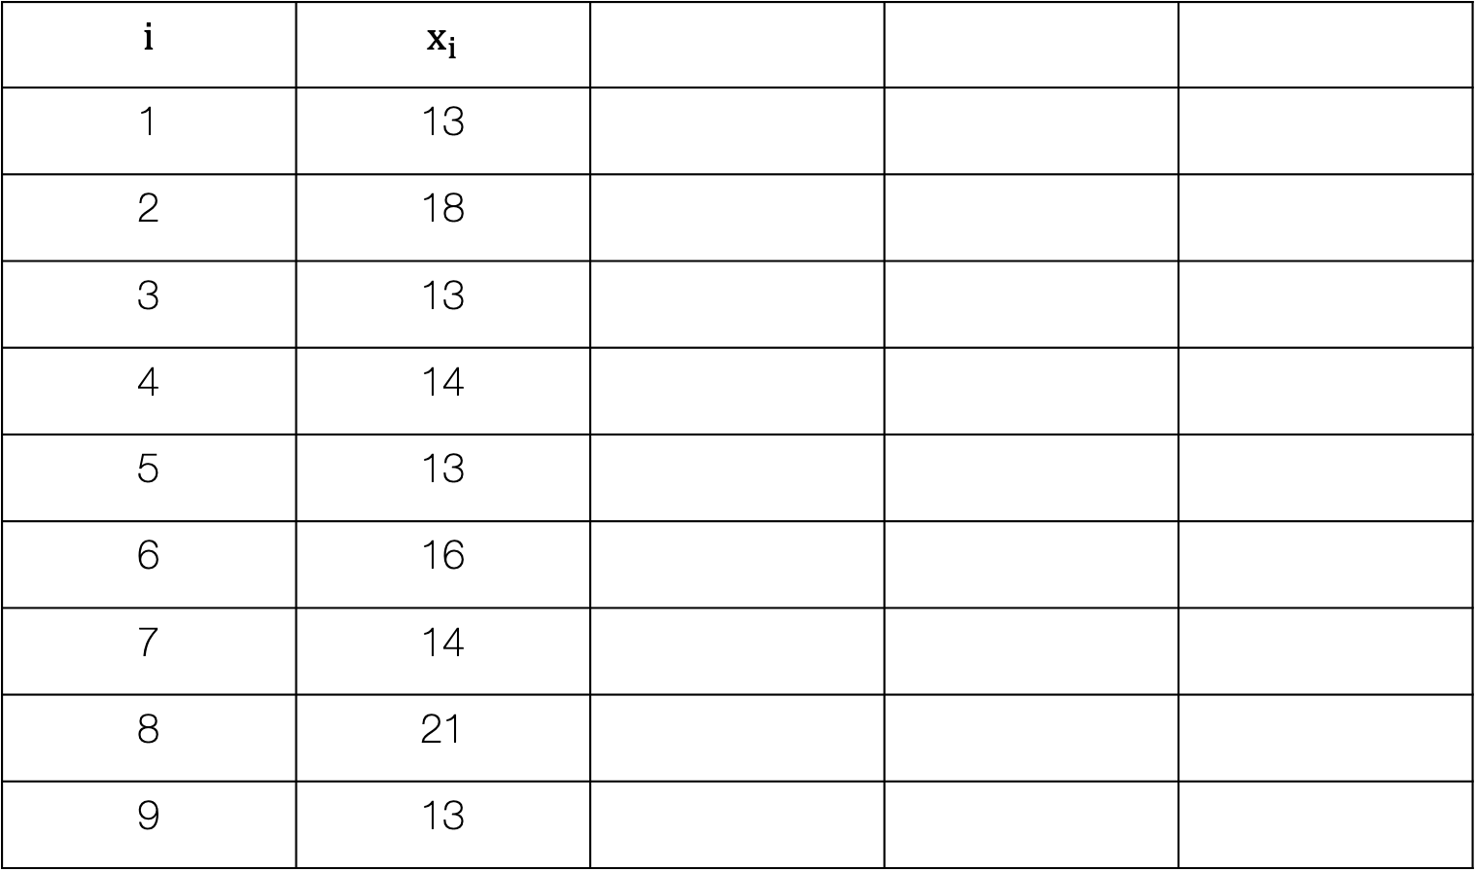
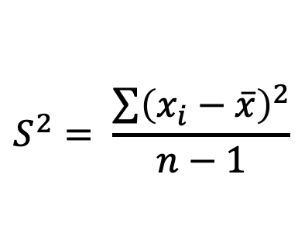
Step 1: List the observations accordingly in a table
i.e., 13, 18, 13, 14, 13, 16, 14, 21, 13,
$$S^{2}= \frac{\sum{{\left(x_{i}−\overline{x}\right)}^{2}}}{n−1}$$
$$i$$ | $$x_{i}$$
1 | 13
2 | 18
3 | 13
4 | 14
5 | 13
6 | 16
7 | 14
8 | 21
9 | 13
33

Slide 34

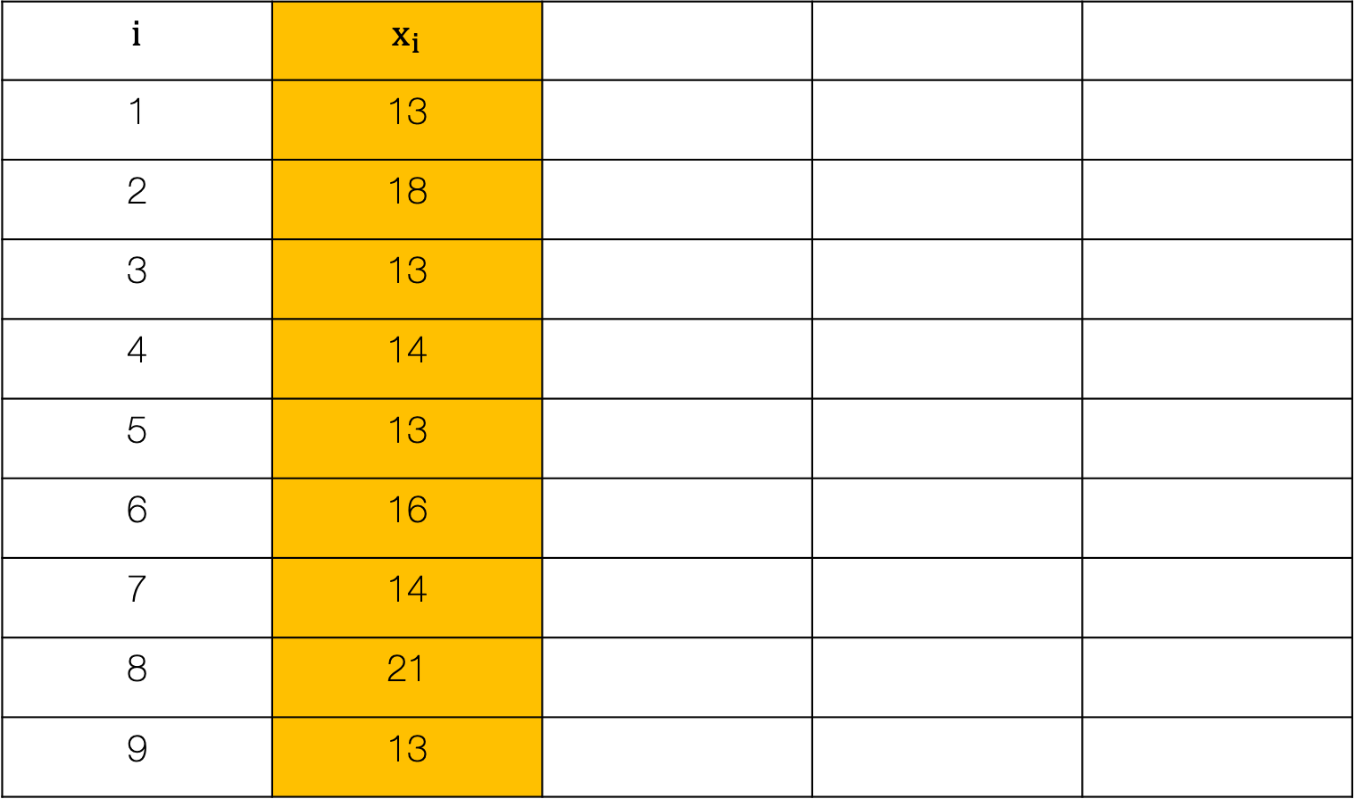
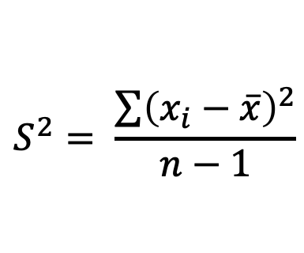
Step 2: Calculate the mean from the list of observed values
$$S^{2}= \frac{\sum{{\left(x_{i}−\overline{x}\right)}^{2}}}{n−1}$$
$$i$$ | $$x_{i}$$
1 | 13
2 | 18
3 | 13
4 | 14
5 | 13
6 | 16
7 | 14
8 | 21
9 | 13
$$Mean: \overline{x}=15$$
34

Slide 35
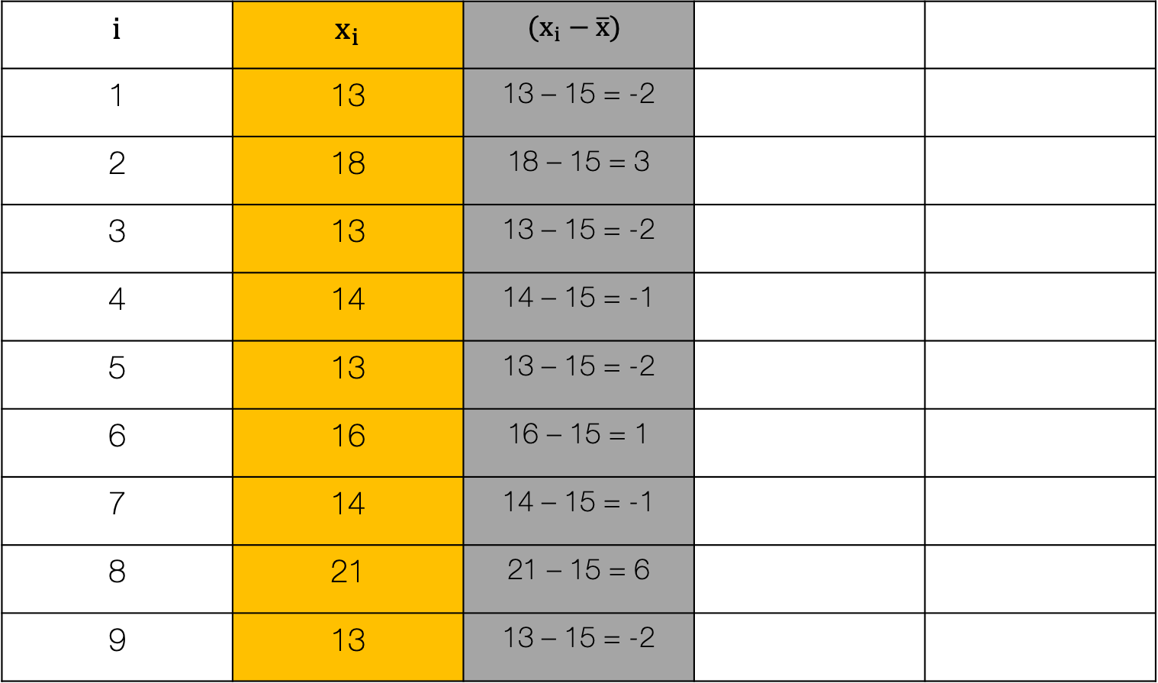
Step 3: Calculate the difference between the observed value and the mean
$$S^{2}= \frac{\sum{{\left(x_{i}−\overline{x}\right)}^{2}}}{n−1}$$
$$i$$ | $$x_{i}$$ | $$(x_{i}−\overline{x})$$
1 | 13 | 13 – 15 = -2
2 | 18 | 18 – 15 = 3
3 | 13 | 13 – 15 = -2
4 | 14 | 14 – 15 = -1
5 | 13 | 13 – 15 = -2
6 | 16 | 16 – 15 = 1
7 | 14 | 14 – 15 = -1
8 | 21 | 21 – 15 = 6
9 | 13 | 13 – 15 = -2
$$Mean: \overline{x}=15$$
35

Slide 36
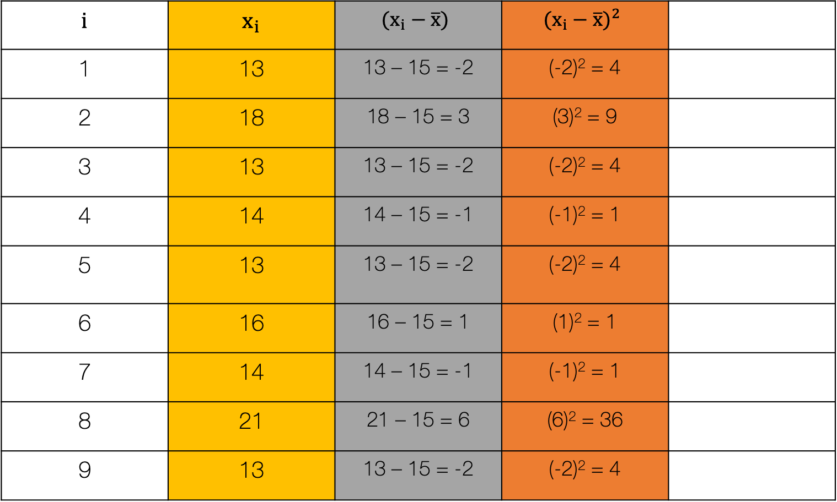
Step 4: Calculate the squared difference between the observed value and the mean
$$S^{2}= \frac{\sum{{\left(x_{i}−\overline{x}\right)}^{2}}}{n−1}$$
$$i$$ | $$x_{i}$$ | $$(x_{i}−\overline{x})$$ | $${(x_{i}−\overline{x})}^{2}$$
1 | 13 | 13 – 15 = -2 | (-2)² = 4
2 | 18 | 18 – 15 = 3 | (3)² = 9
3 | 13 | 13 – 15 = -2 | (-2)² = 4
4 | 14 | 14 – 15 = -1 | (-1)² = 1
5 | 13 | 13 – 15 = -2 | (-2)² = 4
6 | 16 | 16 – 15 = 1 | (1)² = 1
7 | 14 | 14 – 15 = -1 | (-1)² = 1
8 | 21 | 21 – 15 = 6 | (6)² = 36
9 | 13 | 13 – 15 = -2 | (-2)² = 4
$$Mean: \overline{x}=15$$
36

Slide 37
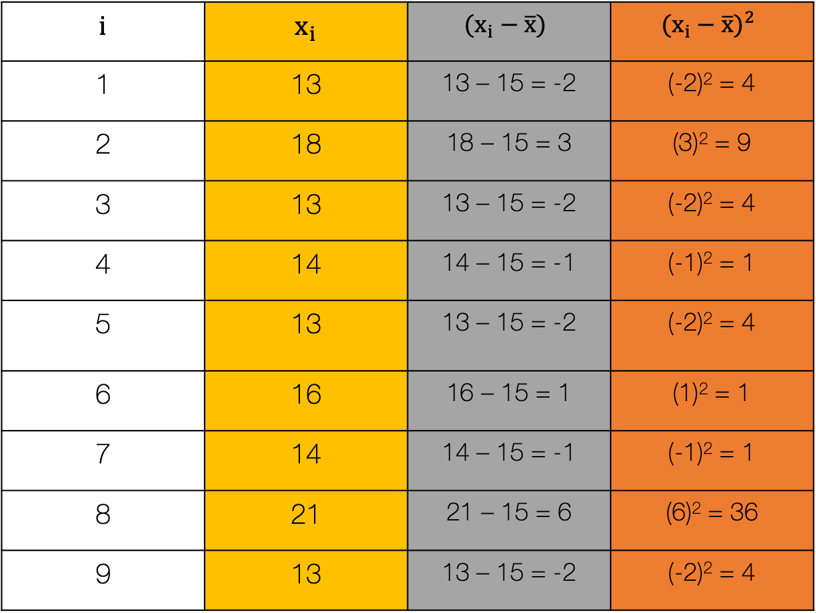
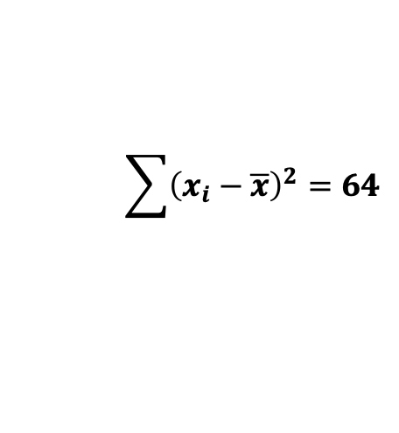
Step 5: Calculate the SUM of the squared differences between the observed value and the mean
$$S^{2}= \frac{\sum{{\left(x_{i}−\overline{x}\right)}^{2}}}{n−1}$$
$$i$$ | $$x_{i}$$ | $$(x_{i}−\overline{x})$$ | $${(x_{i}−\overline{x})}^{2}$$
1 | 13 | 13 – 15 = -2 | (-2)² = 4
2 | 18 | 18 – 15 = 3 | (3)² = 9
3 | 13 | 13 – 15 = -2 | (-2)² = 4
4 | 14 | 14 – 15 = -1 | (-1)² = 1
5 | 13 | 13 – 15 = -2 | (-2)² = 4
6 | 16 | 16 – 15 = 1 | (1)² = 1
7 | 14 | 14 – 15 = -1 | (-1)² = 1
8 | 21 | 21 – 15 = 6 | (6)² = 36
9 | 13 | 13 – 15 = -2 | (-2)² = 4
$$\sum{{\left(x_{i}−\overline{x}\right)}^{2}=64}$$
37
$$Mean: \overline{x}=15$$

Slide 38
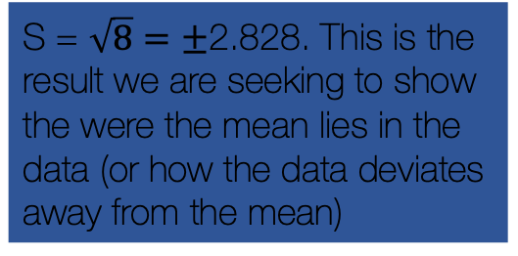
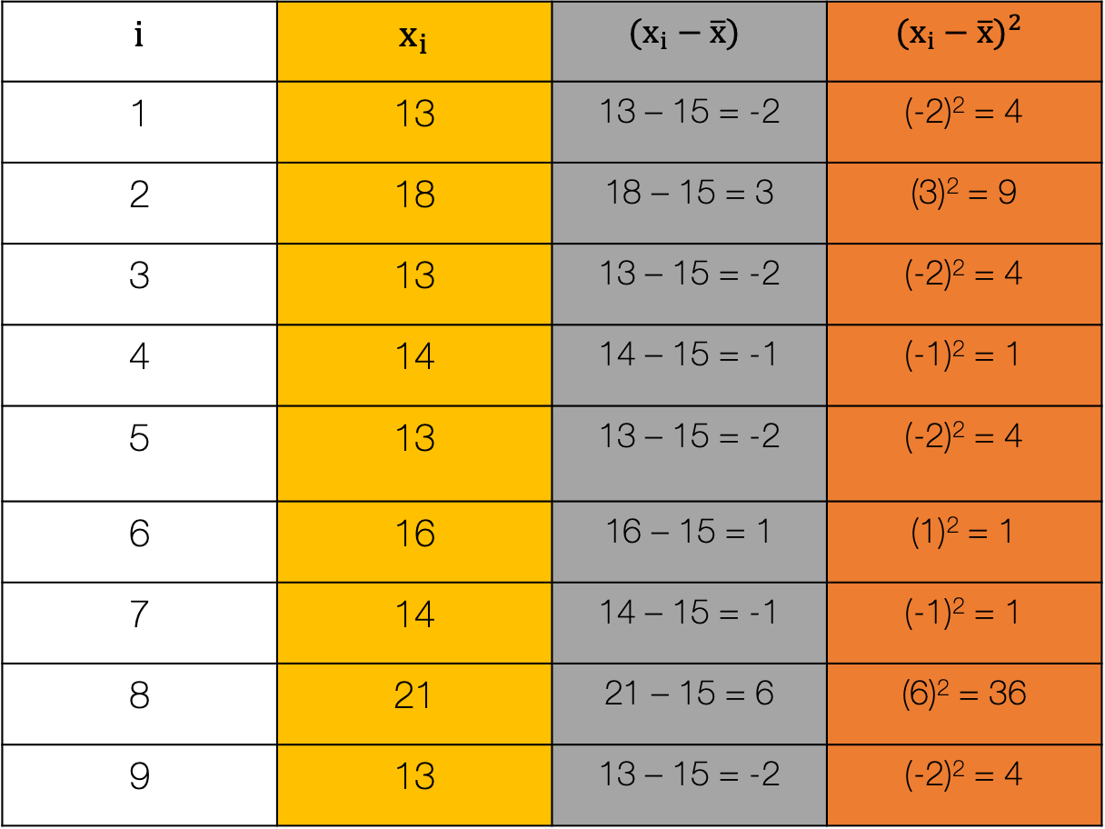
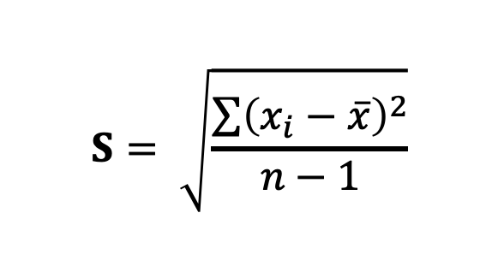
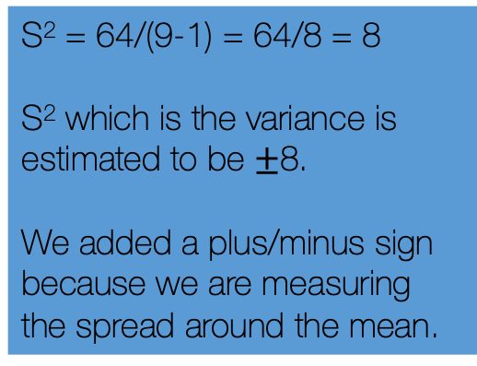
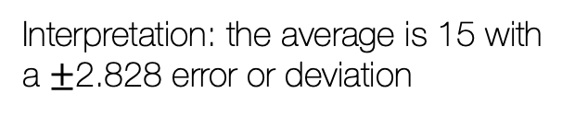
$$S= \sqrt{\frac{\sum{{\left(x_{i}−\overline{x}\right)}^{2}}}{n−1}}$$
$$i$$ | $$x_{i}$$ | $$(x_{i}−\overline{x})$$ | $${(x_{i}−\overline{x})}^{2}$$
1 | 13 | 13 – 15 = -2 | (-2)² = 4
2 | 18 | 18 – 15 = 3 | (3)² = 9
3 | 13 | 13 – 15 = -2 | (-2)² = 4
4 | 14 | 14 – 15 = -1 | (-1)² = 1
5 | 13 | 13 – 15 = -2 | (-2)² = 4
6 | 16 | 16 – 15 = 1 | (1)² = 1
7 | 14 | 14 – 15 = -1 | (-1)² = 1
8 | 21 | 21 – 15 = 6 | (6)² = 36
9 | 13 | 13 – 15 = -2 | (-2)² = 4
S² = 64/(9-1) = 64/8 = 8
S² which is the variance is estimated to be $±$8.
We added a plus/minus sign because we are measuring the spread around the mean.
S = $\sqrt{8}=±$2.828. This is the result we are seeking to show the were the mean lies in the data (or how the data deviates away from the mean)
Interpretation: the average is 15 with a $±$2.828 error or deviation
$$\sum{{\left(x_{i}−\overline{x}\right)}^{2}=64}$$
38
$$Mean: \overline{x}=15$$

Slide 39
Break
39

Slide 40
Presentation of Descriptive Results
40

Slide 41
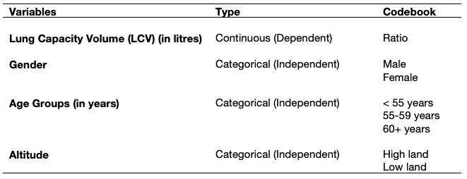
Here, we present some examples of how you should present a result for descriptive analysis
Example: Suppose you conducted a survey among 654 respondents in living in the East Midlands. You want to determine the overall distribution of Lung Capacity Volume among these individuals.
41

Slide 42
An example show the overall distribution of a dependent variable that is continuous
Data for LCV, 654 response:
3.124, 3.172, 3.160, 2.674, 3.685, 5.008, 3.757, 2.245, 3.961, 3.826, 2.806, 3.205, 4.579, 4.354, 4.774, 3.796, 2.416, 3.634, 5.056, 5.812, 2.200, 1.768, 0.517, 5.734, …
Full interpretation: The overall mean LCV among the 654 respondents from East Midlands was 5.91 litres (with SD of ±2.60) with the following quantiles being: Median = 5.64; IQRs 3.94 to 7.35. The lower observed LCV was 0.37 and the highest was 15.37.
No need to worry about presenting any of this in a table etc. Just provide a direct interpretation like above.
Use a table when you have to provide several summary estimates on the fly, or summaries estimates broken down by several other categorical variables
42

Slide 43
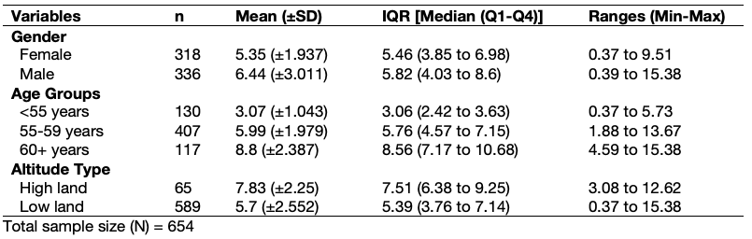
An example of a table showing the overall breakdown of a dependent variable that is continuous by various categorical attributes that are treated as independent variables
Table 1: Shows a descriptive breakdown (by characteristics)of the lung capacity function (i.e., volume) among 654 respondents in the East Midlands.
Interpretation
In terms of gender - overall, men on average have a higher LCV than women [mean: 6.44 (±3.011) vs. 5.35 (±1.937)]
In terms of age group - those in the lowest age group on average have higher LCV compared to the other age groups
Those who live in an area that’s high land have higher LCV than Low landers [mean: 7.83 (±2.25) vs. 5.7 (±2.55)]
43

Slide 44
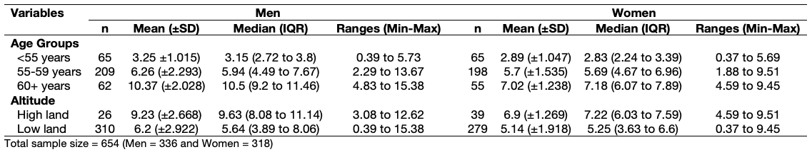
An example of a table showing the overall distribution of a dependent variable that is continuous across other characteristics grouped/stratified by a categorical attribute
Table 2: Shows a descriptive analysis of the lung capacity function (i.e., volume) stratified by gender.
Some note on interpretation (should be comparative)
You can provide a descriptive interpretation that is gender-specific
You can also do a descriptive cross-comparisons to compare the magnitude in differences
You can also do checks for dose-response relationships – e.g., altitude from low --> high shows LCV increase; age groups, from lowest to highest, shows (weirdly) LCV increasing.
44

Slide 45
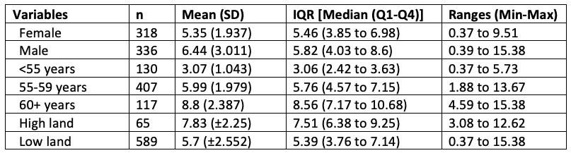
Presentation of tables [1]
Table 2: Shows a descriptive analysis of the lung capacity function (i.e., volume) stratified by gender. Data is from among 654 respondents from the East Midlands.
Best Standards:
Fully formatted table, with table legends which looks great, and its of the standards that is considered publication-worthy. This type will yield you full marks i.e., correct results and show an eye details.
Normal Standards:
Partially formatted table, with no table legends which looks rudimentary. No way near considered publication-worthy (i.e., in a report, research article, thesis etc.). The marker will be like “meh”… but if s/he (i.e., marker) is pissed-off or woke up on the wrong side of the bed, they may deduct marks.
45

Slide 46
Presentation of tables [2]
# A tibble: 2 × 9
gender n mean sd median q1 q3 min max
<chr> <int> <dbl> <dbl> <dbl> <dbl> <dbl> <dbl> <dbl>
1 female 318 5.35 1.94 5.46 3.85 6.98 0.373 9.51
2 male 336 6.44 3.01 5.82 4.03 8.60 0.388 15.4
# A tibble: 3 × 9
agegroup n mean sd median q1 q3 min max
<chr> <int> <dbl> <dbl> <dbl> <dbl> <dbl> <dbl> <dbl>
1 <55 years 130 3.07 1.04 3.06 2.42 3.63 0.373 5.73
2 55-59 years 407 5.99 1.98 5.76 4.57 7.15 1.88 13.7
3 60+ years 117 8.80 2.39 8.56 7.17 10.7 4.59 15.4
# A tibble: 2 × 9
altitude n mean sd median q1 q3 min max
<chr> <int> <dbl> <dbl> <dbl> <dbl> <dbl> <dbl> <dbl>
1 high land 65 7.83 2.25 7.51 6.38 9.25 3.08 12.6
2 low land 589 5.70 2.55 5.40 3.76 7.14 0.373 15.4
Very bad standards:
Just a direct copy of the R console, not tabulated.
46
Notes:
A Negan pu

Slide 47
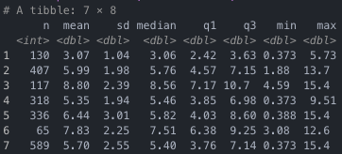
Presentation of tables [3]
Worst standards:
Even worse… just a snapshot of the R console.
47
Notes:
A Negan pu

Slide 48
Live demonstration time – Summary Statistics [CLICK: DOWNLOAD DATASET]
48

Slide 49
Any questions?
49

